Slide 1
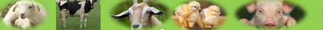
Pig Production and Management
Michael Luwe
Veterinarian
Department of Animal Health and Livestock Development

Slide 2
Pig Production and Management
Common breeds of Pigs
Large White or Yorkshire
Landrace
Duroc
Tri-Star
Indigenous breed
Malawi has all the above except Duroc.

Slide 3
Large White or Yorkshire
Large, long, white pig of British origin
It has dished face and straight ears.
Has wide adaptability under varying conditions hence used for crossbreeding in tropics.
Most prolific with an average litter size of 12 and sows are good mothers.
Breed is slow in maturing but efficient in feed conversion, high growth rates and lean carcasses
The breed is susceptible to sunburn and heat stroke when hot.

Slide 4
Landrace
Can be Danish, Swedish or German types
It has a straight face and drooping ears.
The breed is white and has an average litter size of 11.
Landrace requires close management
It has normally poor mothering ability
The breed is susceptible to sunburn and heat stroke when hot.

Slide 5
Tri-Star
It is a composite breed with:
50% Large White
25% Landrace
25% Duroc
It is hardy and adaptable to all environments.
Developed to produce large lean meat (with less fat)
It has good mothering ability.

Slide 6
Indigenous breed
Widely distributed in African and Asian countries.
Have varying colours with black being dominant.
Well adapted to tropical conditions.
Often reared as scavengers or for backyard systems.
Slow growing and not very prolific but early maturing.

Slide 7
Advantages of Pig Production
Pigs are omnivores hence capable of utilising by-products and waste.
Highly prolific as compared to other livestock species.
Disadvantages of Pig Production
Competes for food with man.
Associated with social and religious taboos.

Slide 8
Meat Products terminologies
Bacon – processed meat usually from heavy pigs weighing above 100kgs live-weight. The meat has more fat than lean meat and bones.
Pork – meat consumed in fresh state from young early maturing pigs weighing 45 to 55kg live-weight. Pork comprises of more lean meat than fat.
Cutter – meat from pigs not qualifying as pork or bacon and usually culled old breeding animal. Its meat is mainly used in making sausages and pork pies.
Lard – pig fat

Slide 9
Systems of Production
i. Free-range (Extensive system)
Simple and cheap system used for raising indigenous pigs.
Pigs housed or tied at night and free-range during daytime.
Sometimes are provided with feed supplement depending on availability e.g. bananas, kitchen waste
Indiscriminate breeding and high disease incidences e.g. African Swine Fever, Cysticeercosis.
Poor growth rate
Notes:
Are scavengers and clean up the environment as they pick up whatever they can eat

Slide 10
Improvements in free-range system
Regular provision of supplementary feeds to those on scavenging – left-overs from human foods (swill), by products such as bran and other waste feeds
Practice controlled breeding and probably introduce improved sires to upgrade them.
Provide proper housing and confine the pigs.
Practice record keeping.
Deworm the pigs

Slide 11
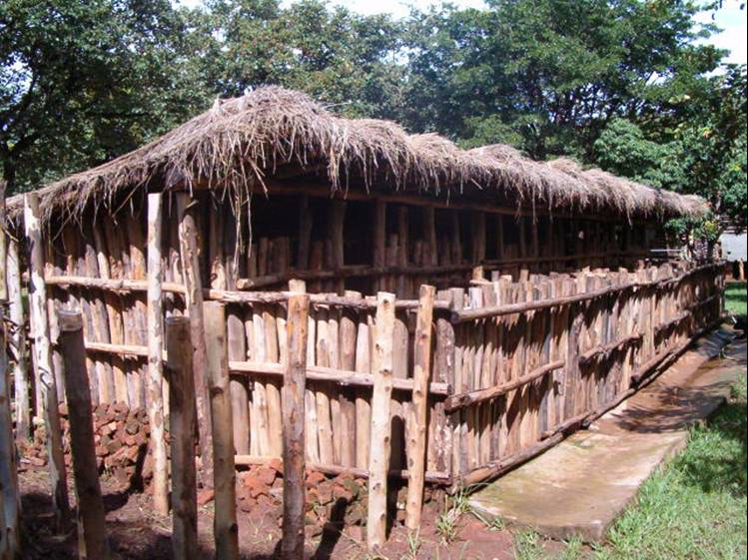
Free-range (Extensive system)
Deep litter structures

Slide 12
Systems of Production
ii. Intensive system
This is mainly done by commercial producers
The total number of pig farms and commercial pig production is increasing in tropical countries
Exotic breeds are raised in confinements
There is use of labour for feeding, watering, cleaning the pens, removal of effluent, assisting mating and furrowing
Houses are cleaned regularly

Slide 13
Systems of Production
iii. Semi intensive system
Not a common system and it requires big land.
Breeding pigs are raised outside on grass in paddocks that have movable food and water troughs
Fattening and nursing pigs are raised intensively in buildings
Gilts and in-pig (pregnant) sows graze with or without boars
The area is fenced and on well-drained soils

Slide 14
Biological Features of Pigs
Heat regulation is ineffective in neonatal pigs.
Young pigs are poorly insulated against coldness due to sparse hair coat and thin layer of subcutaneous fat. As they grow, more fat is deposited, providing better insulation.
Pig skin is poorly vascularised and has no sweat glands for cooling by evaporation. This makes them poorly adapted to high temperatures.
Loss of heat in pigs is through panting, wallowing and moistening their skins.

Slide 15
Biological Features of Pigs
Pigs are borne with poor glycogen reserves hence easily susceptible to hypoglycaemia (blood sugar deficiency) within the first week of life if exposed to cold stress and inadequate milk intake.
Milk of a sow is low in iron and can only supply one-fifteenth of what piglets require.
On the other hand, piglets are borne with adequate iron but depletes fast due to their fast growth during first 3 weeks.
This requires supplementing iron within 3 – 7 days
Naturally pigs dig on earth and acquire iron. (through scavenging).

Slide 16
Housing
Site
The place should have good drainage and not waterlogged.
It should be away from residences.
The site must be on the downwind side of human settlements.
The site selected should be easily accessible.
It should be close to a reliable water and feed sources and pig market.

Slide 17
Housing
Design
House should be constructed in an east-west direction to protect pigs from adverse environmental condition.
It should have provision for food and water.
Provision of dry and hygienic conditions.
Strong and secure walls
The floor should provide insulation against both cold and damp.
The floor should not be too rough nor too smooth.
Easy to clean floors
Roof should provide good insulation and shade

Slide 18
Floor Space Requirement for Growing Pigs Based on Live-weight
Live-weight (Kg) | Area (m²) per Pig
Less than 10 | 0.15
10 – 20 | 0.20
20 – 30 | 0.30
30 – 50 | 0.40
50 – 85 | 0.55
85 – 110 | 0.65
Above 110 | 1.0

Slide 19
Floor Space Requirement for Pigs Based on Production Stage
Production stage / type of pig | Floor space (m²/pig)
Weaned sow | 1.80
Pregnant sow grouped | 4.00-6.00
Pregnant sow, individually confined | 1.50
Farrowing pen with guard rails and creep area, 6 week period | 8.00-11.00
Weaning and growing pigs | 0.36-0.46
Boars, with mating space | 9.30

Slide 20
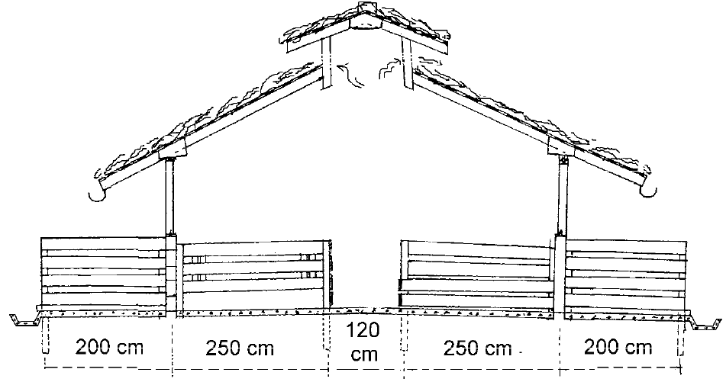
Example of a Pigsty – Side view
Source: Agromisa, 2011

Slide 21
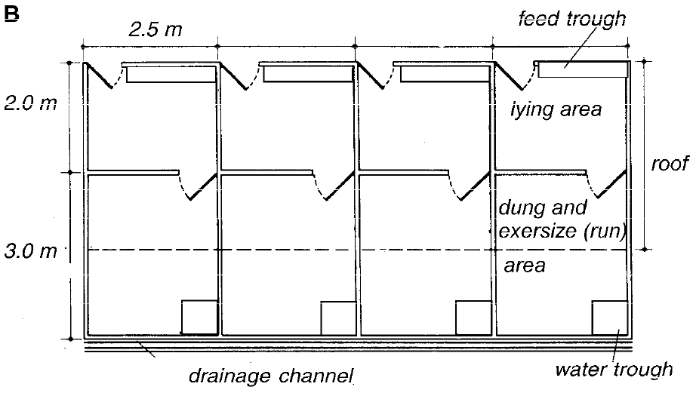
Example of a Floor Plan
Source: Agromisa, 2011

Slide 22
Farrowing Pen
A farrowing pen is a specialized enclosure or housing unit designed to house a sow before, during, and after farrowing. Its main purpose is to protect the piglets, ensure sow comfort, and make management easier.
It should have the following features:
Creep for warmth, feeding and protection
Comfortable sleeping area for the sow
Dunging and feeding area with a clean water source.
Farrowing rails (Guard rails) should be 0.2 m from the wall and 0.2 m high.
Provide creep area with an infrared lamp.
Lactating sows require 4 – 6 m² per sow.

Slide 23
Pig Feeding
Common locally available feed sources for pigs are:
Maize bran, rice bran, beer wastes, cassava peels, swill
Whole feed rations can be formulated from maize grain, bran, fish meal, sorghum, soybean, meat and bone meal, etc.
Provide water ad libitum.

Slide 24
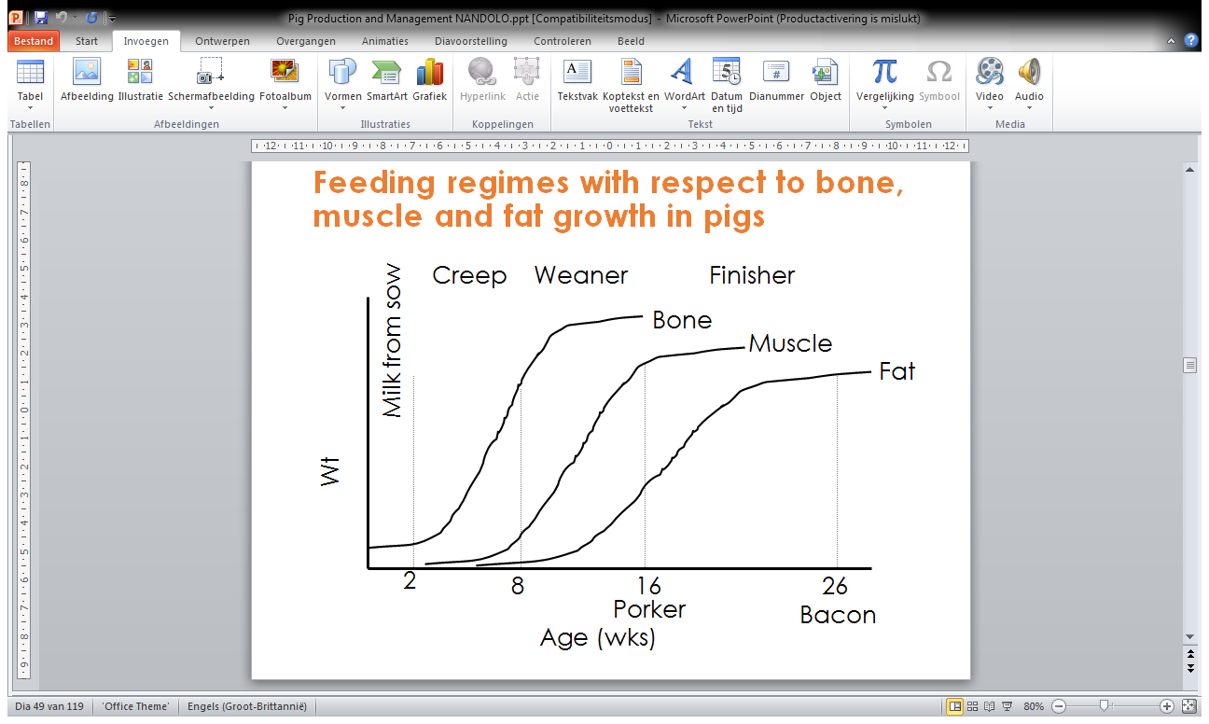
Feeding regimes with respect to bone, muscle and fat growth in pigs

Slide 25
Energy is conserved during resting, leading to an improvement in feed conversion.
Growth rate can be equal to or better than that of birds reared on continuous light when compensatory gain is attained.
Lighting programs designed to prevent excessive growth between 7 and 21 days have been shown to reduce mortality due to ascites, sudden death, leg problems and spiking mortality.

Slide 26
Nutritional requirement for pigs
Feed | Age / wt | DE (opt) | TDN % (opt) | CP % (min) | EE % (max) | CF % (opt) | Lys % (min) | Ca % (opt) | P % (opt)
Milk pellets | 1 – 3 weeks | 3600 | 83 | 22-24 | 5 | 2 | 1.20 | 0.85 | 0.70
Creep feed | 3 wks to 1 week after weaning | 3350 | 76 | 23 | 5 | 5 | 1.00 | 0.85 | 0.70
Weaner feed | Weaning to 35 kg LW | 3135 | 71 | 16.5 | 5 | 5 | 0.90 | 0.85 | 0.70
Fatterner | 35 kg to 60 kg or to porker | 3170 | 72 | 14 | 5 | 5 | 0.70 | 0.80 | 0.65
Finisher | 60 kg to slaughter at 105 kg | 3200 | 73 | 14 | 5 | 5 | 0.65 | 0.80 | 0.65
Sow and Boar | 35 kg onwards | 3000 | 68 | 14 | 5 | 8 | 0.55 | 0.75 | 0.65
From IPC Livestock, Netherlands

Slide 27
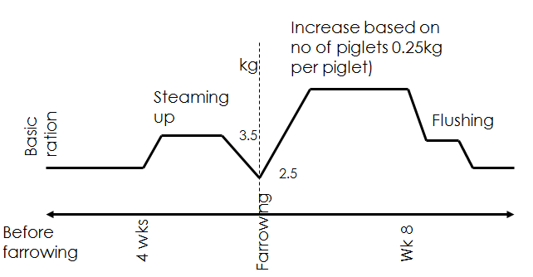
Feeding
Basic level of 2.5 kg per day
Additions based on physiological status

Slide 28
Creep Feeding
Creep feeding helps the piglets to get used to solid diet at an early age.
The feed should be provided from 7 days up to weaning (8 weeks).
Growth rate is better in piglets receiving creep feed than those relying solely on milk.
It also helps in reducing the drain of nutrients from the sow.

Slide 29
Reproduction in Pigs
The age to breed a gilt is 8 months.
The gilt must be between 100 – 120kg live-weight.
Duration of heat period is 2 – 3 days.
One boar can effectively service 15 – 20 sows
Two services at 12 – 14 hours interval required.
Pigs have an 18 – 24 days oestrous cycle (average 21 days).
Heat occurs 2 – 10 days after weaning.
Gestation period in pigs is 115 days

Slide 30
Breeding
It is extremely important to select a good boar since it contributes half the quality of the herd.
Recommended to buy or exchange boar to prevent inbreeding.
Over-utilised boar will be worn out too soon while under-utilisation will make him lazy and too fat.
Always keep an extra boar in case of injury

Slide 31
Selection of Breeding Gilt
Select gilts:
with at least 12 teats so as to accommodate a large litter;
without supernumerary and inverted teats.
from sows which wean 9 -10 or more piglets per litter and are known to be good mothers
That are fast growing weaners (between 5 – 8 weeks or at 16 weeks); and these are likely to consume less feed per unit live weight gain.
good body confirmation i.e. strong legs, sound feet etc.
at least 8 months old at first service.

Slide 32
Selection of Breeding Boar
Boar to have sound feet with good, full hams, uniform curve at the back and of good length.
Boar to be selected from sows, which wean 8 -10 or more piglets per litter and are known to be good mothers.
Boar to be selected from the herd which is having normal sex organs, active, healthy and strong.
Selection to be done before castration i.e. at 4 weeks. Select biggest from the litter.
Boar must be at least 8 months old at first service.

Slide 33
Signs of Heat
General restlessness
Loss of appetite
Redness and enlargement of the vulva
Mucus discharge from the vulva.
Sows will be more alert and the ears will stand up.
Tendency to mount or be mounted by others
It will stand still when pressure is applied to the back.

Slide 34
Factors affecting onset of oestrus
Nutrition
Health of the sow/gilt
Stress
Light
Boar contact
Genotype of the gilt

Slide 35
Common Causes of Poor Conception Rates
The sow is too fat.
Mating pig on its first heat cycle.
Using very young boar.
The boar exhaustion from being overworked (used for more than five matings a week).

Slide 36
Management of Sow during Farrowing
Transfer pregnant sows to farrowing pens 1 – 2 weeks before parturition.
Farrowing takes 2 to 6 hours
Do not interfere when the pig is farrowing.
Signs of farrowing include:
Enlargement of the udder
Restlessness of the sow
Sow start building a nest

Slide 37
Management of Piglets
Cut off the umbilicus approximately 2 cm from the abdomen and disinfect with diluted iodine solution.
If cases of a tail bite are common, cut off the tail to about 4cm on their first day of life.
Ensure that piglets receive colostrum which is enriched with nutrients and maternal antibodies.
Colostrum is produced in the first 1 -2 days and contains antibodies.
Keep piglets in a warm environment during their first 3 – 5 days of life.

Slide 38
Management of Piglets
Castration can be done at an early age (4 weeks).
Iron dextran injection must be administered between 3 – 7 days of life. Alternatively, iron paste can be given orally.
Clip the needle (incisor and canine) teeth during first or second week of life.
Prevent the piglets from being crushed by the sow

Slide 39
Weaning
Piglets can be weaned at 8 weeks although early weaning is sometimes practiced.
It is advisable that the sow must be removed from the piglets and not vice versa. This minimizes stress since the piglets are in a familiar environment.
Sort into group if more than one litter is available.
Put groups in pens that are unfamiliar to all piglets.
Provide correct floor spacing
Once weaned, the sow is supposed to come on heat within 4 – 7 days.

Slide 40
Fostering and Artificial Rearing
Fostering can happen when, for example, there are too many piglets against the number of teats on a sow.
Foster sows should be in approx. the same stage of lactation as the mother sow.
Piglets can also be reared artificially with cow’s milk or milk substitutes. It is by no means as effective as rearing on their own mother’s milk.
An example of milk formula:
2.5 litres fresh
150ml fresh cream
8 beaten eggs
Small quantities should be given every 2 – 3 hrs.
Start by giving 50ml and then increase to 90 – 100ml at approx. 3 wks of age

Slide 41
Identification
Pig identification is necessary for accurate performance records
Identification can be done through use of ear notches, ear tattoos, and ear tags (rare).
Ear notching is the simplest method of identification
Not more than 2 notches per quadrant.
1-3-9 system used
Right ear is used for litter mark
Left ear used for individual pig marks

Slide 42
Record Keeping
Record keeping is vital in any livestock enterprise.
Some of the types of records kept:
Breeding records
Feeding
Individual animal cards
Health
Financial

Slide 43
Marketing
Most pigs are sold informally through middlemen who take them to local markets or slaughter them for meat.
Individual sales at local markets by pig farmers and auctioning of live pigs are also done in some areas.
Others sale to meat traders on contract.
At local markets, pigs are usually slaughtered at slaughter slabs which are separate from other livestock and its meat is sold ungraded.
Some processing factories buy pigs and they are slaughtered and processed into various products.

Slide 44
Pig Health
Biosecurity is the best preventive measure.
Pigs are highly susceptible to diseases when stressed hence ensure good animal welfare.
Worms, African Swine Fever, mange and anaemia are some of the notable diseases which occur when management has been compromised.
Be able to pick out early signs of a disease and react promptly.
Always ensure that sick pigs are isolated from the rest.

